Slide 1

Smart Home Management System
Efficient Device Control & Automation using BST
Team: Suhaas Sarabu & Vishnu Polemera
Project Work | Department of CSE

Slide 2
The Problem
Traditional IoT management systems often suffer from linear search bottlenecks. As households add dozens of smart devices, managing state, power, and automation logic requires a highly optimized and scalable architecture.

Slide 3

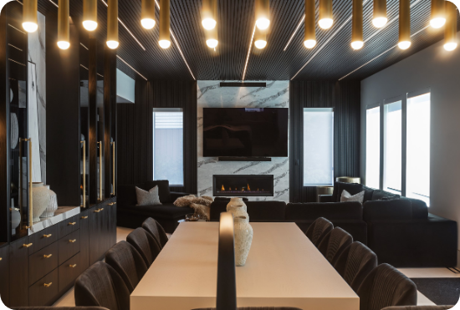
Real-world Application
IoT Ecosystems
•
Energy Efficiency: Real-time tracking of power usage.
•
Home Automation: Seamless control of AC, Fans, and Lights.
•
Dynamic Scalability: Easily add/remove devices in large networks.
•
Environmental Sensing: Auto-adjusting to climate & time.

Slide 4

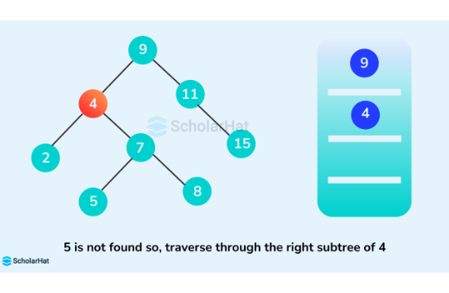
Data Structure: BST
Why Binary Search Tree?
Our system uses a BST to store device nodes. This provides:
•
Efficiency: Average O(log n) for Search, Insert, and Delete.
•
Sorting: Devices are automatically ordered by unique ID.
•
Memory: Dynamic allocation allows for minimal footprint.

Slide 5







System Architecture
Device Node
Control Logic
Interface
Stores ID, Name, Room, Status, and Power metrics for each connected appliance.
Recursive algorithms traverse the tree to apply automation rules based on sensors.
A CLI-based hub allowing CRUD operations and real-time monitoring of power.

Slide 6

Smart Automation
Temp Logic
Night Mode
User Presence
If Temp > 28°C, AC turns ON. If Temp > 26°C, Fan turns ON.
Detects time of day. If Night = True, Lights automatically switch ON.
Safety override: If User is Away, all devices are forced OFF to save energy.

Slide 7
Implementation Metrics
Module | Function Name | Complexity | Role
Creation | insert() | O(log n) | Registers new smart devices into BST.
Search | search() | O(log n) | Locates specific device by unique ID.
Power | totalPower() | O(n) | Recursive calculation of active load.
AI Engine | smartHomeControl() | O(n) | Traverses tree to apply global rules.

Slide 8
Demo Execution Output
INPUTTING DATA (CHOICE 1)
Choice: 1
ID: 101 | Name: AC
Status (ON/OFF): ON
Room: BDRM
Power assigned: 20
DISPLAY REGISTRY (CHOICE 5)
ID | Name | Sts | Room | Power
5 | LIGHT | OFF | HALL | 5
10 | AC | OFF | BDRM | 20
101 | AC | ON | BDRM | 20
SEARCH & UPDATE (CHOICE 3/4)
Choice: 4 | ID: 101
Found -> ID:101 | AC | ON | BDRM
New name: COOLER
Device updated successfully!
SMART ACTIVATION (CHOICE 6)
Temp: 30 | Night: 1
Smart System Activated...
Power Usage: 35 units
Devices adjusted automatically!

Slide 9
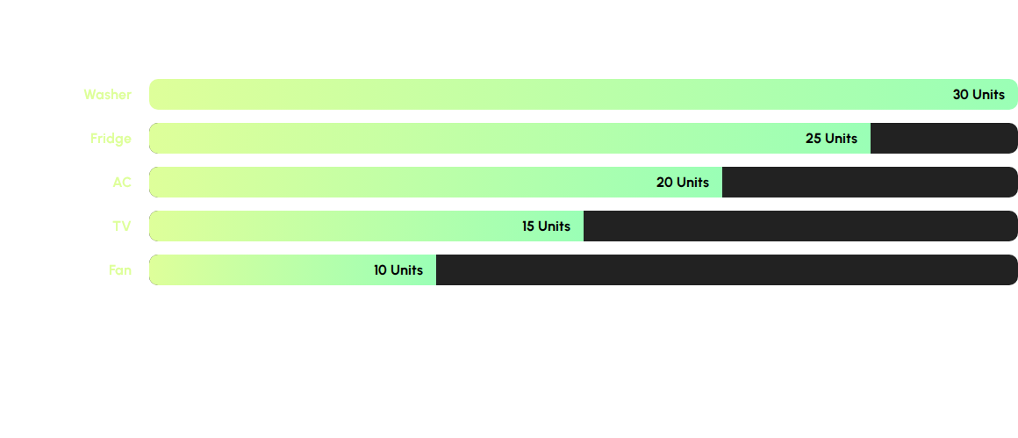
Power Analytics
Aggregate Power consumption is dynamically recalculated during every "Smart System" cycle.

Slide 10



Project Conclusion
Our Smart Home Management System successfully integrates Binary Search Trees to solve the scalability and efficiency challenges of modern IoT environments. The system provides a robust framework for energy conservation and user comfort.
Efficient
Scalable
Autonomous

Slide 11


The Future
Next Steps
•
Hardware Integration: Arduino/NodeMCU links.
•
AI Optimization: Predictive energy usage.
•
Self-Balancing Trees: AVL implementation.
•
Web Dashboard: GUI-based monitoring.

Slide 12
Any Questions?
Thank you for your attention!
Suhaas Sarabu | Vishnu Polemera

